Slide 1
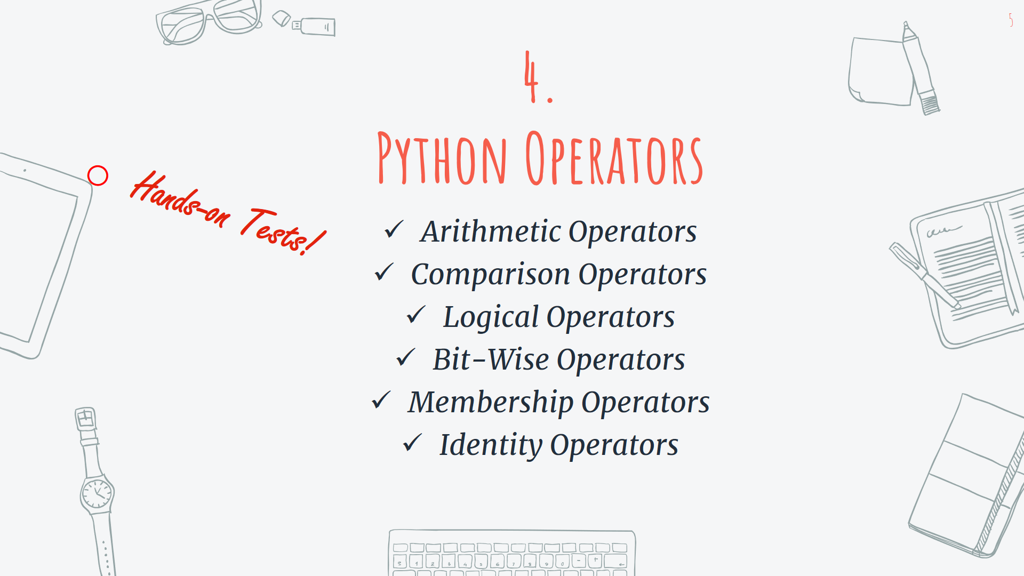

Slide 2
Contents
1
Arithmetic Operators
2
Comparison Operators
Logical Operators
Bit-Wise Operators
Membership Operators
Identity Operators
3
4
5
6

Slide 3
Arithmetic Operators
Operator | Operation | Example
+ | Addition | X + Y
- | Subtraction | X – Y
* | Multiplication | X * Y
/ | Division | X / Y
% | Modulus | X % Y
** | Exponentiation | X ** Y
// | Floor Division | X // Y

Slide 4
Operator | Example | Same as
= | X = 1 | X = 1
+= | X += 2 | X = X + 2
-= | X -= 3 | X = X – 3
*= | X *= 4 | X = X * 4
/= | X /= 5 | X = X / 5
%= | X %= 6 | X = X % 6
//= | X //= 7 | X = X // 7
**= | X **= 8 | X = X ** 8
&= | X &= 9 | X = X & 9
|= | X |= 10 | X = X | 10
^= | X ^= 11 | X = X ^ 11
>>= | X >>= 12 | X = X >> 12
<<= | X <<= 13 | X = X << 13

Slide 5
Contents
1
Arithmetic Operators
2
Comparison Operators
Logical Operators
Bit-Wise Operators
Membership Operators
Identity Operators
3
4
5
6

Slide 6
Comparison Operators
Operator | Operation | Example
== | Equal | X == Y
!= | Not equal | X != Y
> | Greater than | X > Y
< | Less than | X < Y
>= | Greater than or equal to | X >= Y
<= | Less than or equal to | X <= Y

Slide 7
Contents
1
Arithmetic Operators
2
Comparison Operators
Logical Operators
Bit-Wise Operators
Membership Operators
Identity Operators
3
4
5
6

Slide 8
Logical Operators
Operator | Description | Example
and | Returns True if both statements are true | x > 7 and x < 12
or | Returns True if one of the statements is true | x < 5 or x > 10
not | Reverse the result, returns False if the result is true | not(x > 7 and x < 12)

Slide 9
Contents
1
Arithmetic Operators
2
Comparison Operators
Logical Operators
Bit-Wise Operators
Membership Operators
Identity Operators
3
4
5
6

Slide 10
Bit-Wise Operators
Operator | Operation | Example
& | AND | Sets each bit to 1 if both bits are 1
| | OR | Sets each bit to 1 if one of two bits is 1
^ | XOR | Sets each bit to 1 if only one of two bits is 1
~ | NOT | Inverts all the bits
<< | Zero fill left shift | Shift left and left-most bit falls off
>> | Signed right shift | Shift right and right-most bit falls off

Slide 11
Contents
1
Arithmetic Operators
2
Comparison Operators
Logical Operators
Bit-Wise Operators
Membership Operators
Identity Operators
3
4
5
6

Slide 12
Membership Operators
Operator | Description | Example
in | Returns True if the value exists in the object | X in Y 23 in my_list
not in | Returns True if the value does not exists in the object | X not in Y “Hey” not in my_list

Slide 13
Contents
1
Arithmetic Operators
2
Comparison Operators
Logical Operators
Bit-Wise Operators
Membership Operators
Identity Operators
3
4
5
6

Slide 14
Membership Operators
Operator | Description | Example
is | Returns True if both variables are the same objects | A is B A is 23
is not | Returns True if variables are not the same objects | A is not B A is not 49
What does it mean, being the same object?
2. The difference between “==“ and “is” ?
Let’s see some examples…

Slide 15

Thanks!
Got any questions or suggestions?
Here’s some contact info:
@KMasoumi

